Slide 1
Web Technologies
Irshad Ullah
Department of Computer Science
COMSATS University Islamabad, Attock Campus

Slide 2
Introduction to Web Development:
Internet vs. Web; client-server request-response model
Core terminology: URL/URI, HTTP/HTTPS, DNS, hosting, web server and browser
Web standards and bodies (W3C, WHATWG, ECMA, IETF); application types: static, dynamic, MPA, SPA, PWA
Tiered Web Architecture: one-tier, 2-tier and 3-tier, N-tier

Slide 3
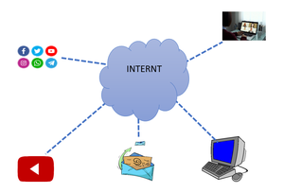
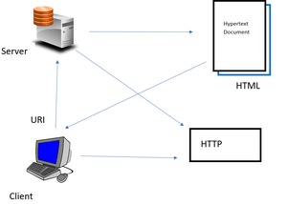
Internet Vs. Web
Internet
  A global system of interconnected computer networks that use TCP/IP protocol to link devices worldwide.
World Wide Web (Web)
  is a collection of information that is accessed via the Internet.

Slide 4
Client-Server Request-Response Model
The Client-Server Model is a network architecture in which clients send requests for resources or services, and servers process these requests, returning the required responses.
Client: A device or program that requests data or services (e.g., a web browser).
Server: A system that stores resources, manages data, and responds to client requests.
Request–response mechanism: Communication follows a structured cycle: the client requests, the server responds.
Centralized management: Data and services are controlled from servers, improving security and consistency.

Slide 5
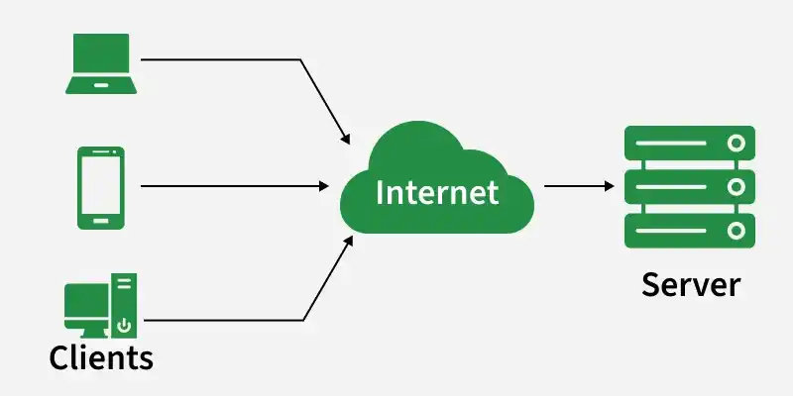
Client-Server Request-Response Model (cont.)
The client-server model works on a request–response flow where a client requests a service/data and the server processes that request and returns a response.

Slide 6
Client-Server Request-Response Model (cont.)
Client is a device/app that requests services from a server, like a web browser or email app.
Server is a system that listens for requests and responds by sending data or performing operations.
Servers can handle many clients at the same time using concurrent request handling.
Example client apps include Chrome/Firefox and Gmail/Outlook.
Example servers include web servers (Apache/Nginx), email servers, and database servers.

Slide 7
Client-Server Request-Response Model (cont.)
User enters a URL in the browser (example: www.example.com).
Browser performs a DNS lookup to convert the domain name into an IP address.
Browser establishes a connection and sends an HTTP/HTTPS request to the server using that IP.
Server responds with website resources like HTML, CSS, JavaScript, and images.
Browser renders the webpage by processing these files and displaying the content.

Slide 8
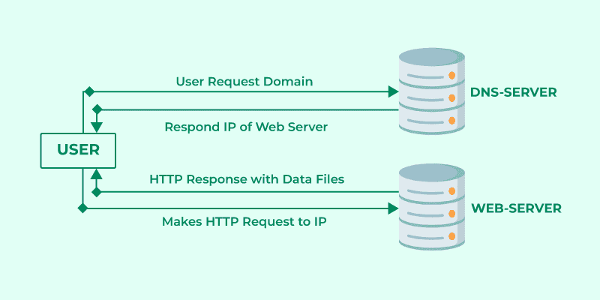
Client-Server Request-Response Model (cont.)

Slide 9
Uniform Resource Identifier (URI)
URI (Uniform Resource Identifier) is also a string of characters that identifies a resource on the web either by using location, name, or both. It allows uniform identification of resources. A URI is additionally grouped as a locator, a name, or both, which suggests it can describe a URL, a URN, or both. The term identifier within the URI refers to the prominence of the resources, regardless of the technique used.
Example: urn:daraz:product:123456789

Slide 10
Uniform Resource Locator (URL)
A URL is a web address used to identify and locate resources on the internet.
It consists of several components, including the protocol (e.g., http:// or https://), domain name (e.g., www.example.com), and path (e.g., /page1).
Forexample: https://www.example.com/page1
protocol
Example: https://www.daraz.pk/products/iphone-15-128gb

Slide 11
Protocol
Hypertext Transfer Protocol (HTTP):
  HTTP is a protocol used for transmitting data between a web server and a web client (usually a web browser). It defines how requests and responses should be formatted and handled.
HTTP Secure (HTTPS):
  HTTPS is a secure version of HTTP. It encrypts data exchanged between a web server and a client to protect against eavesdropping and data tampering.

Slide 12
Domain Name
  A domain name is a human-readable address that corresponds to an IP address on the internet.
  It is used to identify websites and resources. For example, "www.example.com" is a domain name.
  A domain name is a string of text that maps to an alphanumeric IP address, used to access a website from client software.

Slide 13
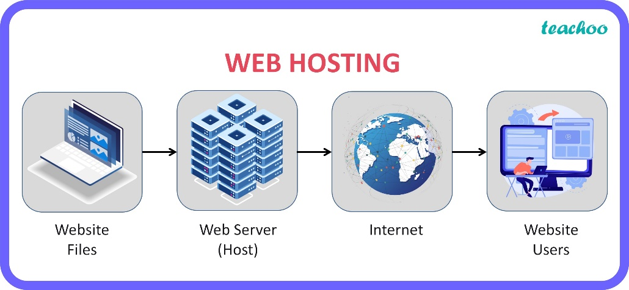
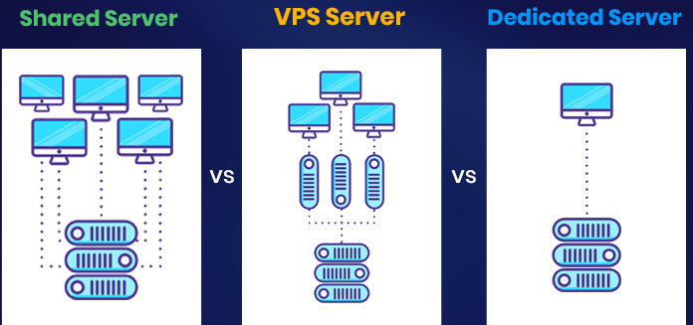
Web Hosting
  Web hosting is a service that provides storage, server resources, and connectivity to make websites accessible on the Internet.
  Different types of hosting include:
    Shared hosting,
    Virtual Private Server (VPS) hosting
    Dedicated hosting.
Notes:
In shared hosting, multiple websites are hosted on a single server. The server’s resources (CPU, RAM, bandwidth, etc.) are shared among all the websites on that server.
VPS hosting provides a virtualized server environment. Although multiple VPS instances are hosted on a single physical server, each VPS has its own dedicated resources and operates independently from others.
Dedicated hosting provides an entire physical server dedicated to a single user or organization. All the server’s resources are available for your website or application.

Slide 14

SEO (Search Engine Optimization)
  SEO is the practice of optimizing a website to improve its visibility in search engine results.
  This involves various techniques to enhance the website's ranking and traffic.
Notes:
Content SEO
Internal linking
BAcklinks
KEYWORD SEARCH

Slide 15




Web Browser
When a user requests a web page from a particular website, the browser retrieves its files from a web server and then displays the page on the user's screen.
  Browsers are used on a range of devices, including desktops, laptops, tablets, and smartphones
  Popular web browsers include Chrome, Firefox, Safari, and Edge.

Slide 16
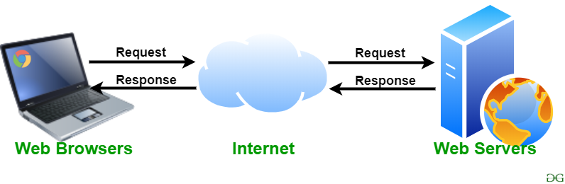
Web Server
A web server is software and hardware that uses HTTP (Hypertext Transfer Protocol) and other protocols to respond to client requests made over the World Wide Web.
  Common web server software includes Apache, Nginx, and Microsoft IIS.
  The main job of a web server is to display website content through storing, processing and delivering webpages to users.

Slide 17
Web Standards
Web standards are official rules and technical guidelines created by international organizations to ensure websites and apps work the same way across all browsers and devices
W3C
WHATWG
ECMA
IETF

Slide 18
Web Standards (cont.)
World Wide Web Consortium (W3C)
  Founded by Tim Berners-Lee, the W3C creates core standards like CSS, SVG, and web accessibility guidelines. The World Wide Web Consortium (W3C) is an international community that develops standards and guidelines for the web
Web Hypertext Application Technology Working Group (WHATWG):
  Formed by major browser vendors (Apple, Mozilla, Google, Microsoft), it maintains the ever-evolving HTML and DOM Living Standards. WHATWG maintains the HTML Living Standard, which describes exactly how HTML (all the HTML elements, their associated APIs, and other surrounding technologies) should be implemented.

Slide 19
Web Standards (cont.)
ECMA
  This organization standardizes information and communication systems, most notably publishing the ECMAScript specification that powers JavaScript. TC39 and ECMA specify and publish the standard for ECMAScript, which modern JavaScript is based on.
IETF
  A global open community of network designers and operators that defines core internet protocols like HTTP, TCP, and URIs. IETF (Internet Engineering Task Force): Internet standards (STD), which, among other things, govern the setup and use of URIs, HTTP, and MIME.

Slide 20
Web Application Types
Static
Dynamic
MPA
SPA
PWA

Slide 21
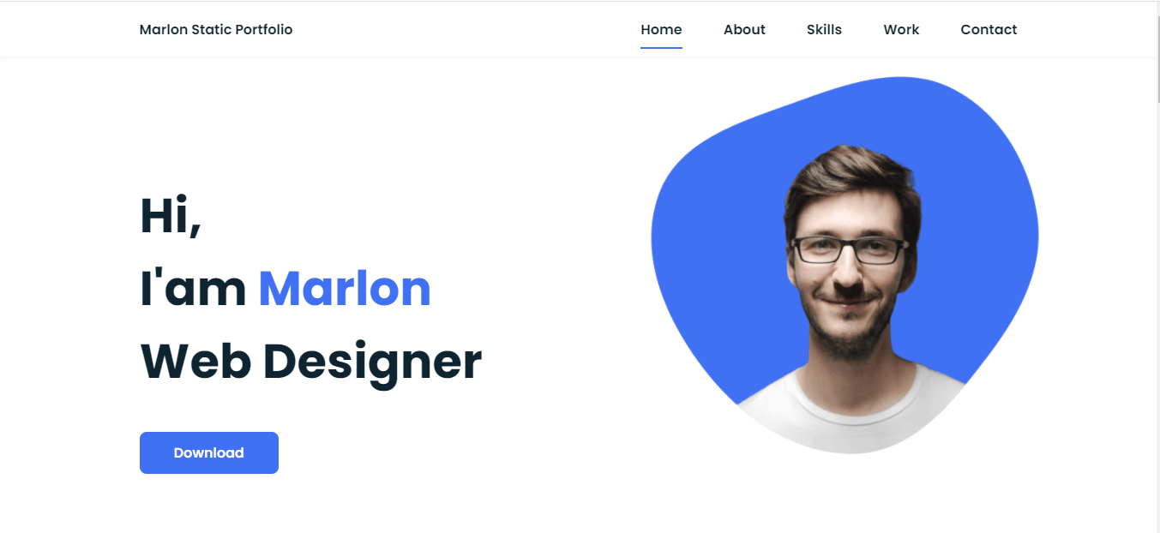
Static Web Applications
Static Applications
Static applications consist of pre-built HTML, CSS, and JavaScript files stored on a server. Every user receives the exact same files.
How it works: When a user requests a page, the server instantly sends the already-created file without doing any processing.
Pros: Extremely fast, highly secure, cheap to host.
Cons: Hard to update in real-time; cannot handle user accounts or personalized content without external APIs.
Ideal for: Portfolios, documentation, landing pages, and company brochures.

Slide 22
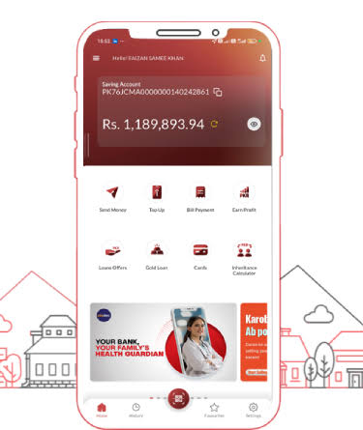
Dynamic Web Application
Dynamic applications generate content in real-time on the server before sending it to the user's browser.
How it works: When a user visits a page, the server fetches data from a database, pieces it together with an HTML template, and delivers the custom page.
Pros: Allows for personalized content, user logins, and real-time data updates.
Cons: Slower loading times due to server processing; complex to build and scale.
Ideal for: E-commerce sites, banking portals, and content management systems (like WordPress).

Slide 23
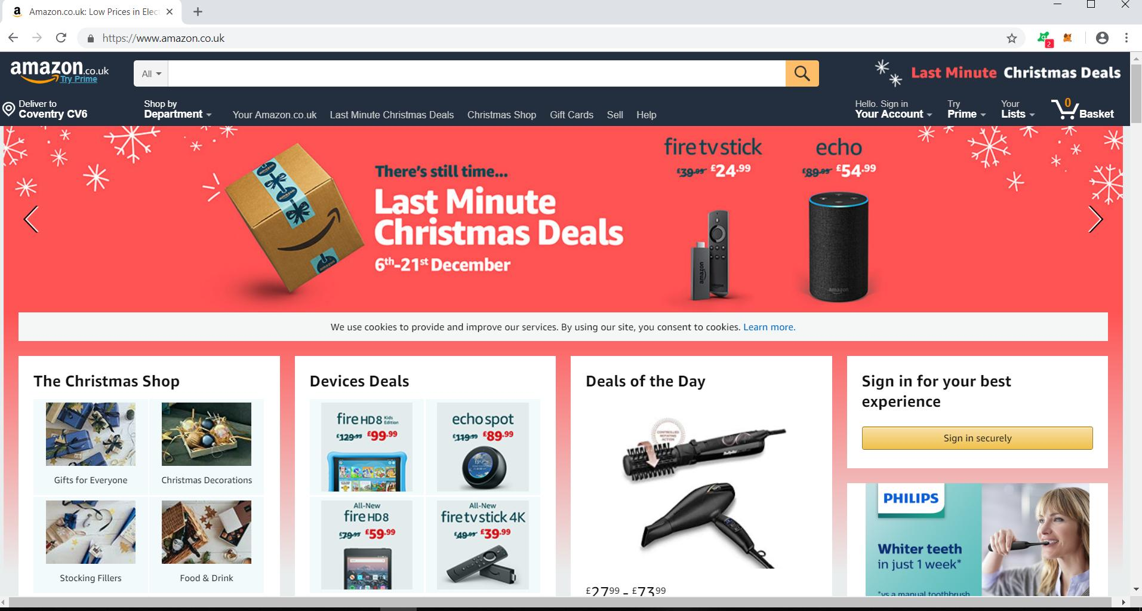
Multi-page Application (MPA)
An MPA is the traditional web model where the application consists of multiple distinct HTML pages.
How it works: Every time a user clicks a link, the browser requests a completely new page from the server, causing the entire screen to refresh or "blink."
Pros: Excellent for Search Engine Optimization (SEO) because every page has its own unique URL and pre-rendered content.
Cons: Poor user experience during navigation due to constant page reloads.
Ideal for: Large online marketplaces, news portals, and massive directories.
Example: Amazon, eBay

Slide 24
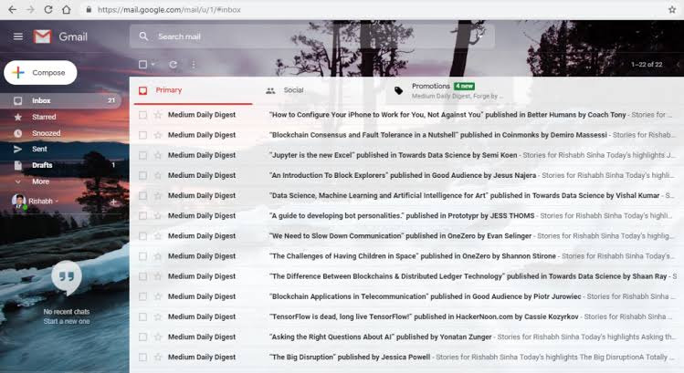
Single Page Application (SPA)
An SPA interacts with the user by dynamically rewriting the current web page rather than loading entire new pages from a server.
How it works: The browser downloads a single HTML file and a massive chunk of JavaScript code on the first visit. As the user clicks around, JavaScript fetches only the necessary data in the background and updates the screen instantly without a full page reload.
Pros: Fluid, app-like user experience; feels incredibly fast after the initial load.
Cons: Slow first-time load; traditionally more difficult for search engines to index (SEO challenges).
Ideal for: Interactive dashboards, social media platforms (like Facebook or X), and email clients (like Gmail).

Slide 25
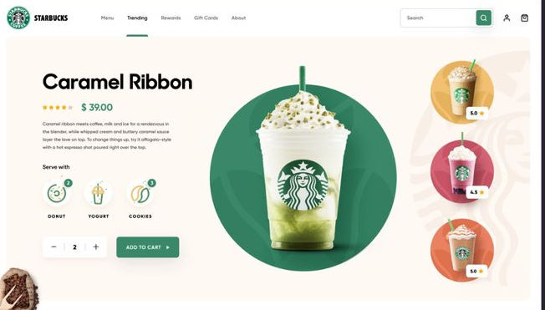
Progressive Web Applications (PWA)
A PWA is a website built with web technologies that behaves like a native mobile app. It is not a replacement for SPAs or MPAs, but rather an enhancement layer built on top of them.
How it works: It uses "Service Workers" (scripts running in the background) to cache assets, allowing the site to load instantly and function without an internet connection.
Pros: Can be installed on a phone's home screen, works offline, sends push notifications, and bypasses app stores.
Cons: Limited access to certain native hardware features compared to true mobile apps.
Ideal for: Mobile-first platforms, productivity tools, and applications aiming for high mobile retention.

Slide 26

Web Architectures
26
The following layers are used in web application development:
  Presentation layer/user interface layer.
  Application layer/business logic layer.
  Data layer.

Slide 27

Presentation Layer
It is the layer that is visible to the user and the one with which the user interact.
The user gives the inputs and instructions through this and the output is also displayed on it.
Example: An e-commerce website where users can browse products, view product details, add items to their cart, and proceed to checkout. The web pages users interact with, including buttons, forms, images, and menus, constitute the presentation layer.

Slide 28
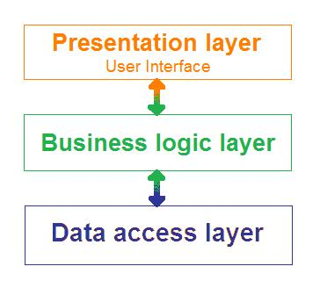
Application Layer
This layer contains all the models and logics provides the functionality to the application.
It also acts as an intermediate between the user interface and the database layer.
In simple words it performs operations on the application.

Slide 29
Data Layer
The data layer, sometimes referred to as the database layer, data access layer, or back-end, is where the information processed by the application is stored and managed.
This can be a relational database management system such as PostgreSQL, MySQL, MariaDB, Oracle

Slide 30
1-Tier Architecture
1-tier architecture, also known as single-tier architecture or stand-alone architecture, refers to that kind of software architecture in which all the required components for the working of the application are available under the same package.
It means that the user interface, business, layers are accessible by the application under the same local drive.
Both the client and server reside in the same machine.
It is the simplest application architecture used.
But this tier is not suitable for a web application.
As it can only access data available in a single computer or server.

Slide 31
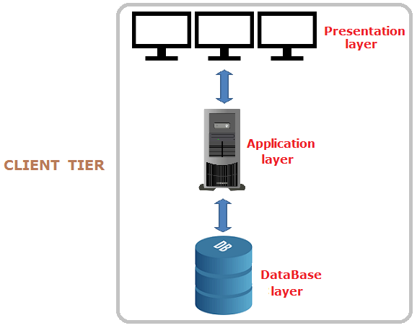
1-Tier Architecture (cont.)

Slide 32
1-Tier Architecture (cont.)
MS Office is a prominent example of 1 tier architecture.
This is a cost-efficient architecture and applications based on this are much easier to build.
Advantages
  cost-efficient
  Maintenance
Disadvantages
    cannot share information
    Unable to work when some changes are done

Slide 33
2-Tier Architecture
The client system handles both Presentation and Application layers and the Server system handles the Database layer.
It is also known as a client-server application. The communication takes place between the Client and the Server. The client system sends the request to the server system and the Server system processes the request and sends back the data to the Client System

Slide 34
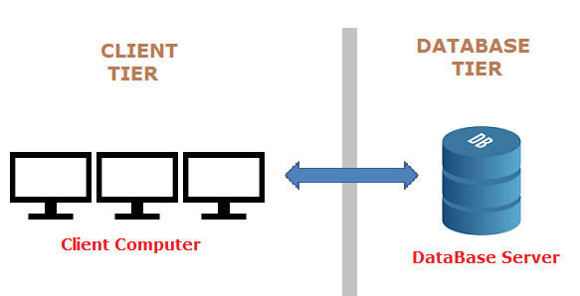
2-Tier Architecture (cont.)
A web application or a mobile app that allows users to check their bank account balances, view transaction history, and transfer funds.

Slide 35
3-Tier Architecture
In a 3-tier architecture, the presentation layer, the business layer, and the database layers are in separate machines.
Unlike 2 tier architecture, 2 servers perform the major tasks in this application.
One server is for the business layer and the other is for the database layer.

Slide 36
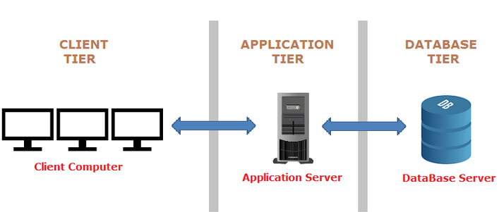
3-Tier Architecture (cont.)

Slide 37
Hyper Text Transfer Protocol
HTTP is a fundamental protocol used for communication between a client (usually a web browser) and a web server over the Internet. It is the foundation of data communication on the World Wide Web, enabling the exchange of text, images, videos, links, and other resources between a user's device and web servers.
HTTP operates on a request-response model, where a client sends a request for a resource, and the server responds with the requested data (usually in the form of an HTML web page). It is a stateless protocol, meaning each request from the client to the server is independent, and the server doesn't retain any information about previous requests.

Slide 38
HTTP Example
Client Makes a Request:
  A user opens a web browser and enters a URL (Uniform Resource Locator), such as "http://www.example.com/page1".
  The browser translates this URL into an HTTP request, which includes:
    The HTTP method (usually "GET" for requesting resources).
    The domain name ("www.example.com").
    The path to the specific resource ("/page1").
Client Sends the Request:
  The client (web browser) establishes a TCP (Transmission Control Protocol) connection to the server hosting www.example.com.
  It sends the HTTP request to the server.
Server Processes the Request:
  The web server at www.example.com receives the HTTP request.
  It parses the request, identifies the requested resource ("/page1"), and locates the corresponding file or generates dynamic content.
Notes:
Transmission Control Protocol (TCP) is a communications standard that enables application programs and computing devices to exchange messages over a network.
TCP is in charge of setting up a reliable connection between two machines and HTTP uses this connection to transfer data between the server and the client.

Slide 39
HTTP Example (cont.)
Server Sends the Response:
  The server constructs an HTTP response, which includes:
    An HTTP status code (e.g., 200 for success or 404 for "Not Found").
    The content type (e.g., "text/html" for HTML pages).
    The requested resource's content (e.g., the HTML code of "page1").
  It sends this response back to the client over the established TCP connection.
Client Receives and Renders the Response:
  The client's web browser receives the HTTP response.
  It processes the response, renders the HTML content, and displays the web page to the user.
Connection Closes:
After the response is sent, the TCP connection is closed, and the HTTP transaction is complete.

Slide 40
Thank You

